Slide 1

Boost in learning rates evokes full transfer in visual perception tasks
Too Bayesic
Pedro Cisneros-Velarde, Suraj Chakravarthi Raja, Wanying Jiang, Katrin Sutter

Slide 2
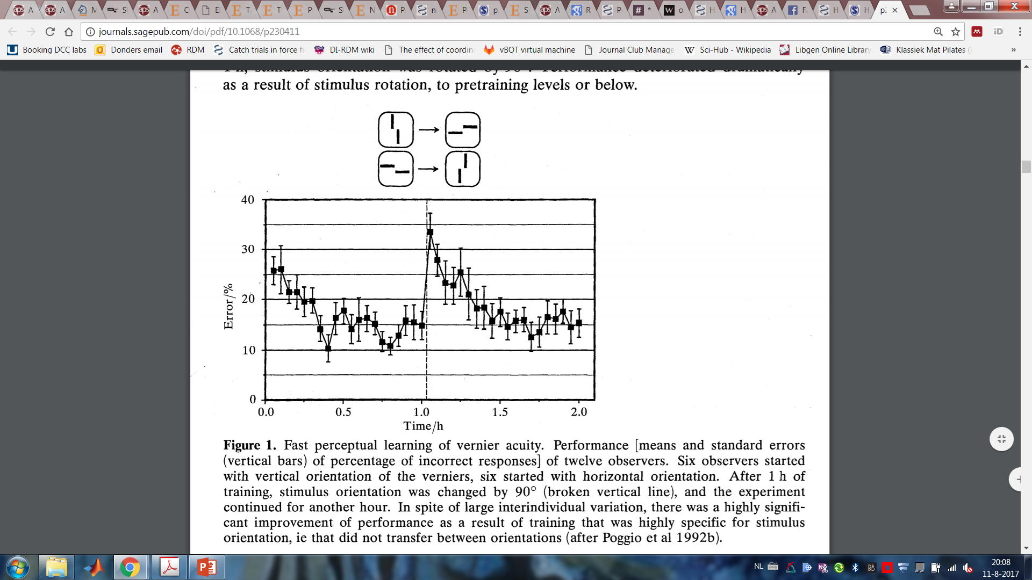
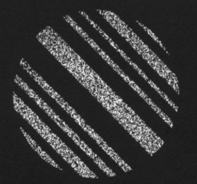
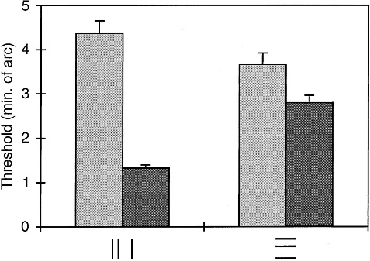
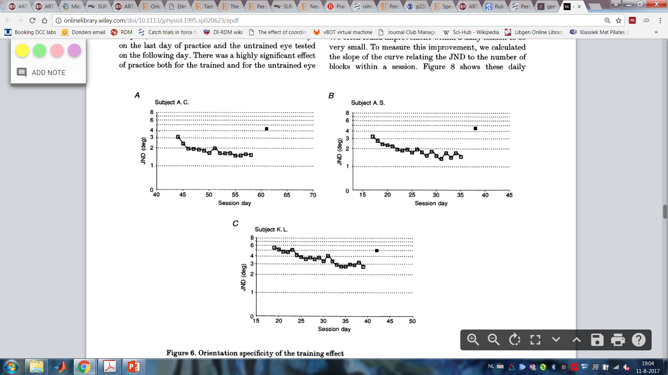
Phenomenon
The improvement in stimulus discrimination is specific in perceptual learning (Crist et al, 1997; Fahle, 1994; Schoups et al, 1995; Werner et al, 2005).
Double-training evokes transfer learning (Xiao et al, 2008; Zhang et al, 2010).
trained orientation
untrained orientation

Slide 3




Double-training
Training: Orientation discrimination
Exposure: Contrast discrimination
Time
Time

Slide 4
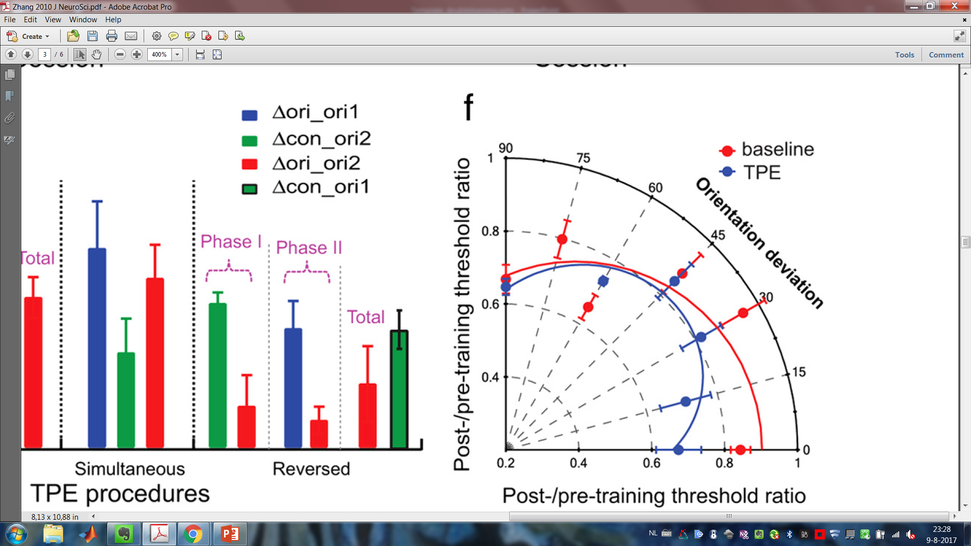
Double-training
Decreased orientation specificity due to double-learning
Training
Double-training
Zhang et al, 2010

Slide 5


Double-training
Testing , Training , Exposure
Case 1: Training first, exposure later
Case 2: Interleaved training and exposure
Case 3: Exposure first, training later
Case 4: Reduced exposure
Notes:
To our knowledge, there is no computational model that explains how double-training evokes learning transfer.

Slide 6
Double-training: Conclusions
Exposure phases must have mutual information with the training phases.
Evidence suggests that training phases boost the learning improvement in the following exposure phases, but not the other way around.

Slide 7
Question and Hypothesis
Question:
How do the length and order of exposure phases affect the transfer of learning?
Hypothesis:
The boost mechanism in the learning rate allows a reduction in the length of exposure phases while achieving full transfer.

Slide 8
Assumptions
Learning is additive and its rate decays exponentially through time in both training and exposure phases.
A learning improvement or boost is enabled in the transition to the first exposure block following a training phase.
The learning in training phases is limited to a maximum learning value while the learning in exposure phases is limited to the accumulated learning of the training phases.
The model assumes full retention between any two blocks.
Notes:
Without loss of generalization, the maximum learning value is assumed to be the unity.

Slide 9
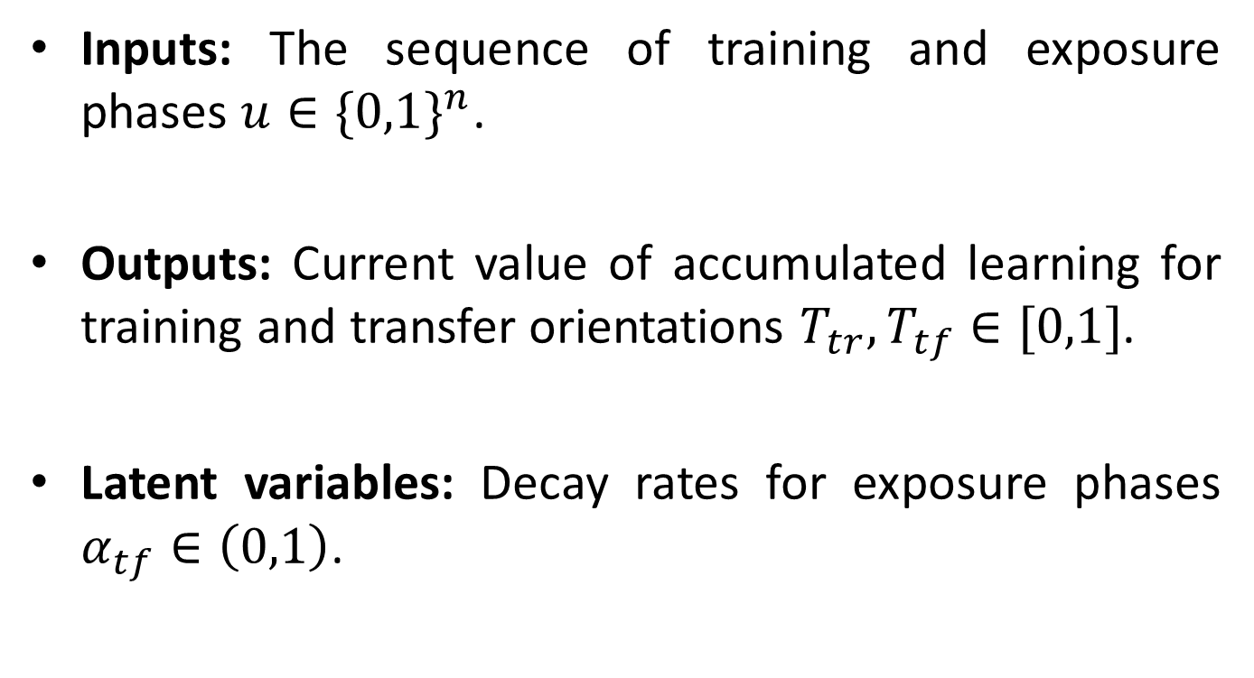
Model Variables
Inputs: The sequence of training and exposure phases $u∈{\{0,1\}}^{n}$.
Outputs: Current value of accumulated learning for training and transfer orientations $T_{tr},T_{tf}∈[0,1]$.
Latent variables: Decay rates for exposure phases $α_{tf}∈\left(0,1\right)$.

Slide 10
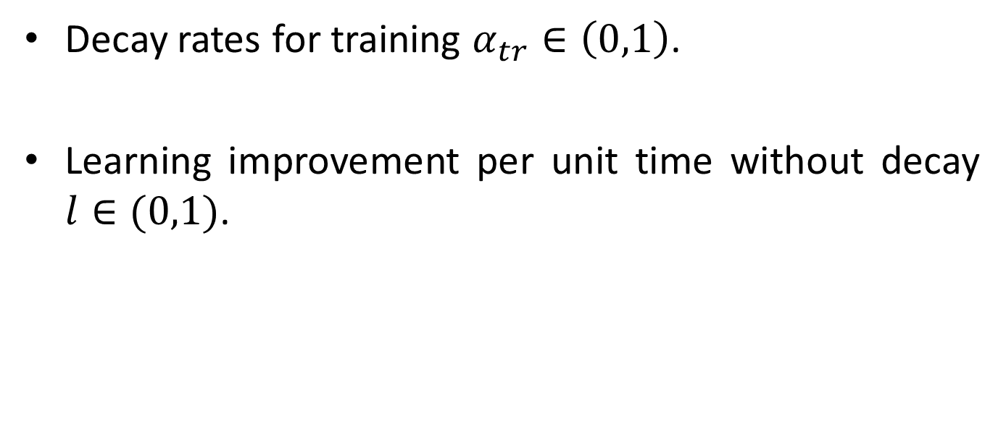
Model Parameters
Decay rates for training $α_{tr}∈\left(0,1\right)$.
Learning improvement per unit time without decay $l∈(0,1)$.

Slide 11
Selected Toolkit
Finite State Machines (FSM)

Slide 12
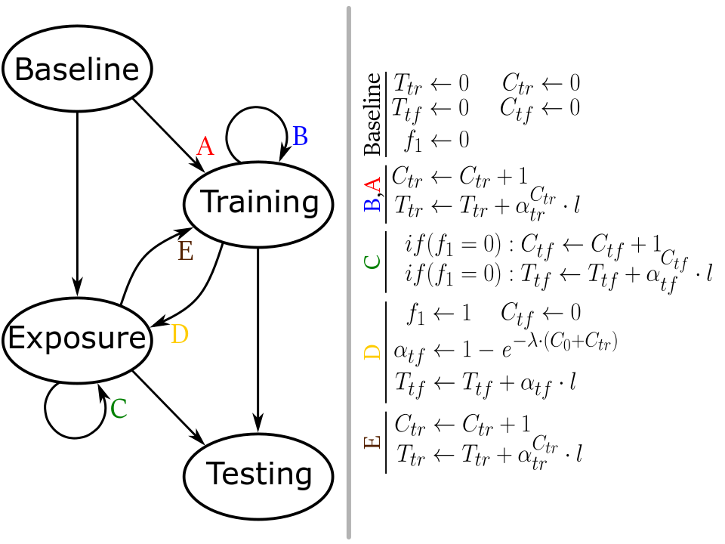
Model Schematics

Slide 13
Model Schematics

Slide 14
Model Schematics
1)
1)

Slide 15
Model Schematics

Slide 16
Model Schematics
1)
1)

Slide 17
Simulations (I)
There are 15 training blocks and at most 15 exposure blocks are inserted at different positions among the training blocks.
All of these simulations replicate the qualitative behaviour of the data.
Notes:
Results must relate to the hypothesis. Explicit

Slide 18
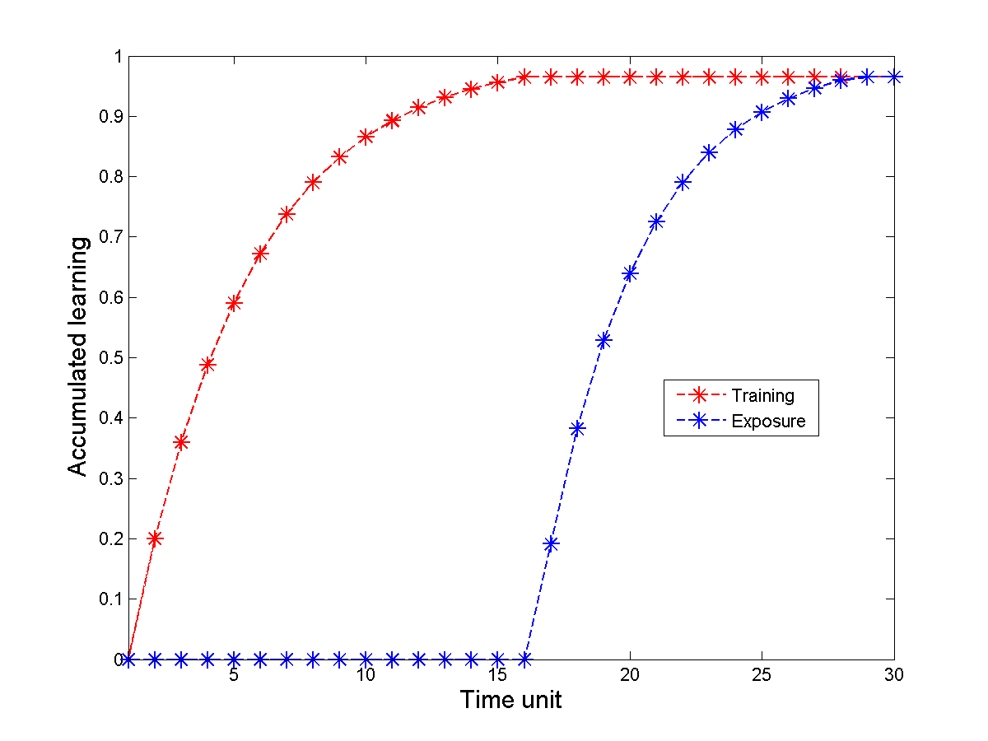
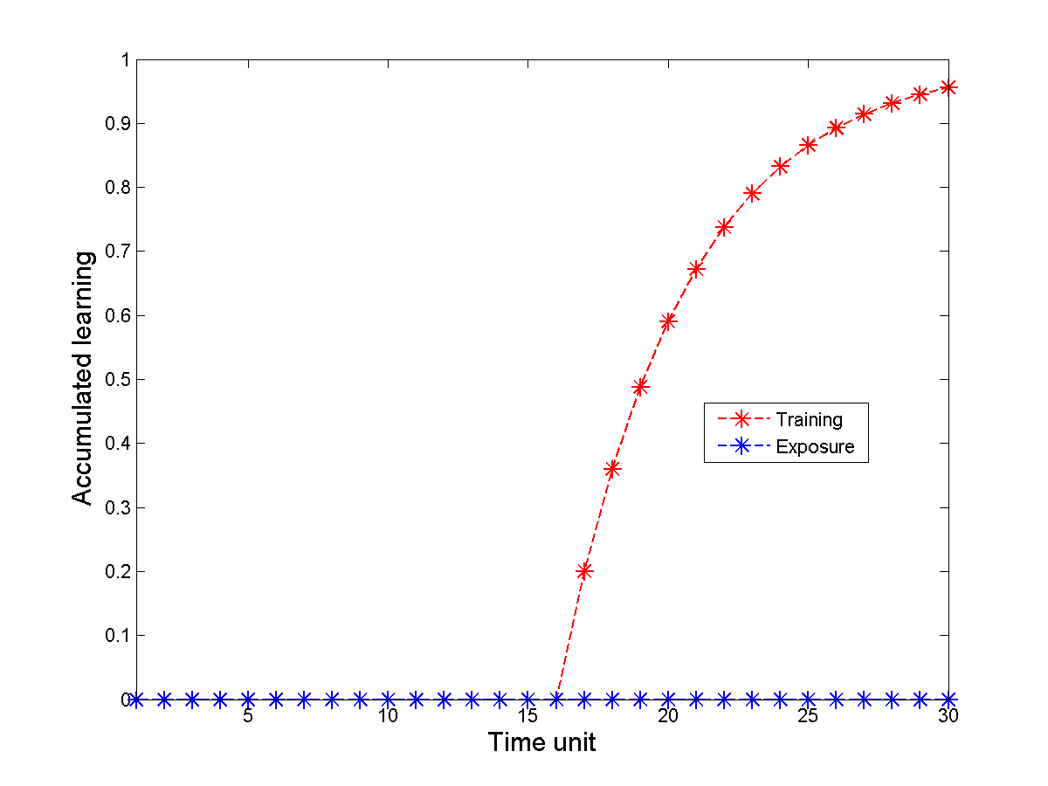
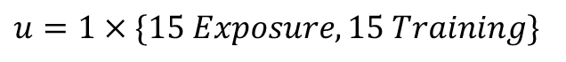
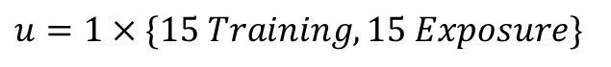
Simulations (I)
$u=1×\{15 Training,15 Exposure\}$
$u=1×\{15 Exposure,15 Training\}$
Notes:
Results must relate to the hypothesis. Explicit

Slide 19
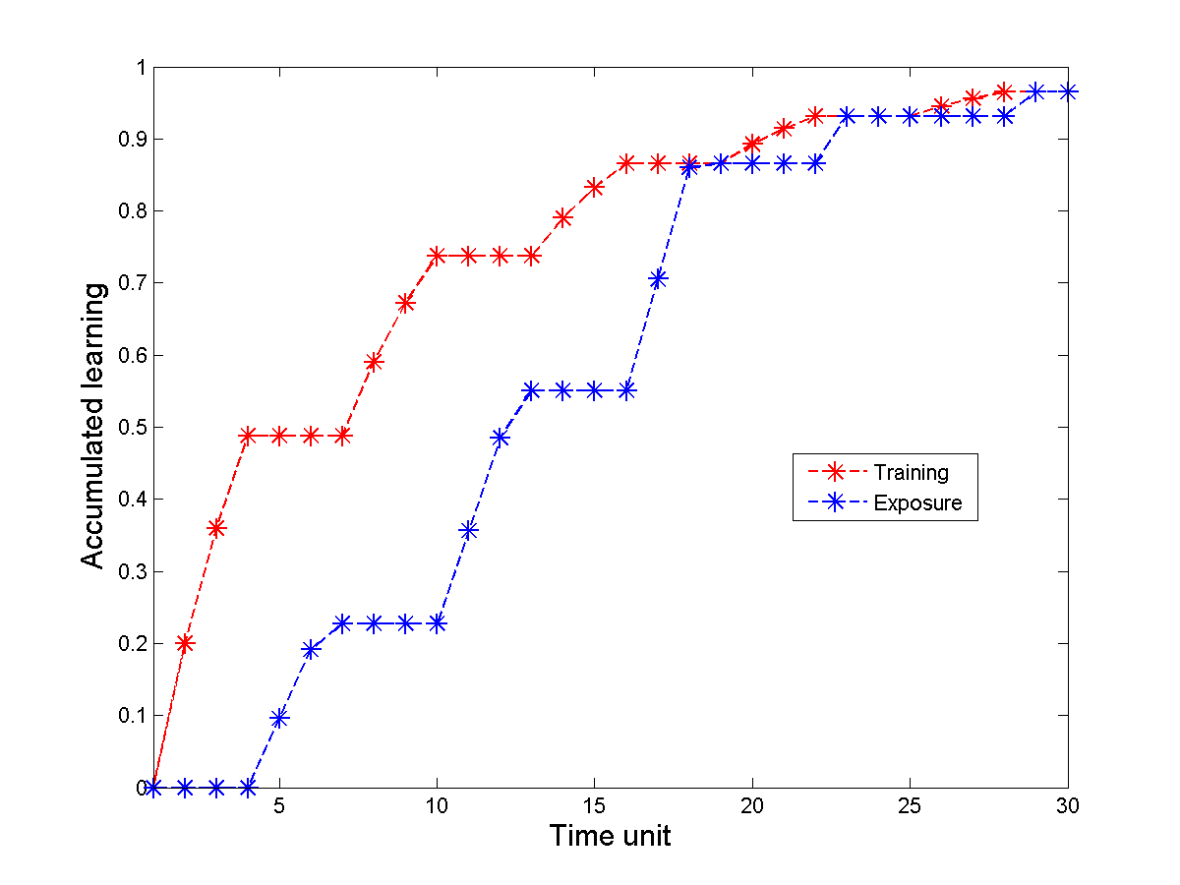
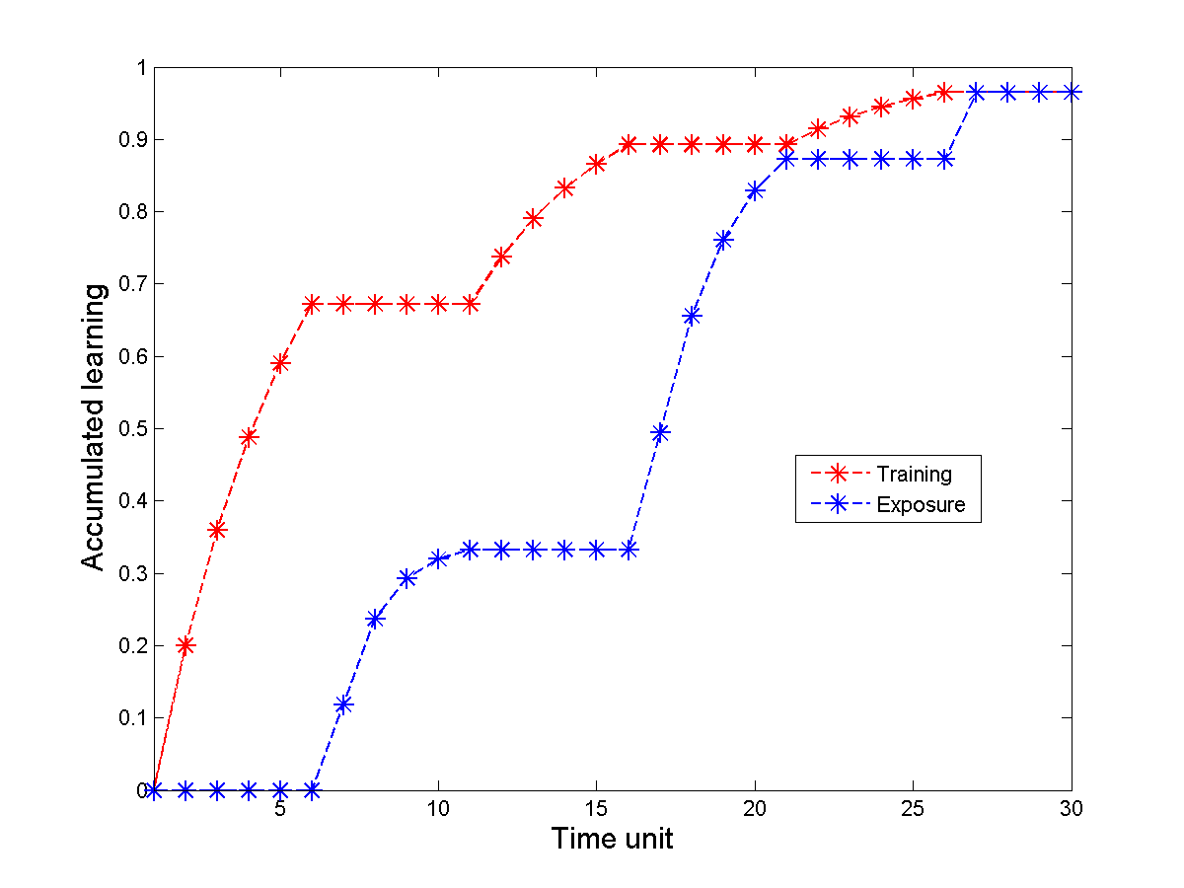
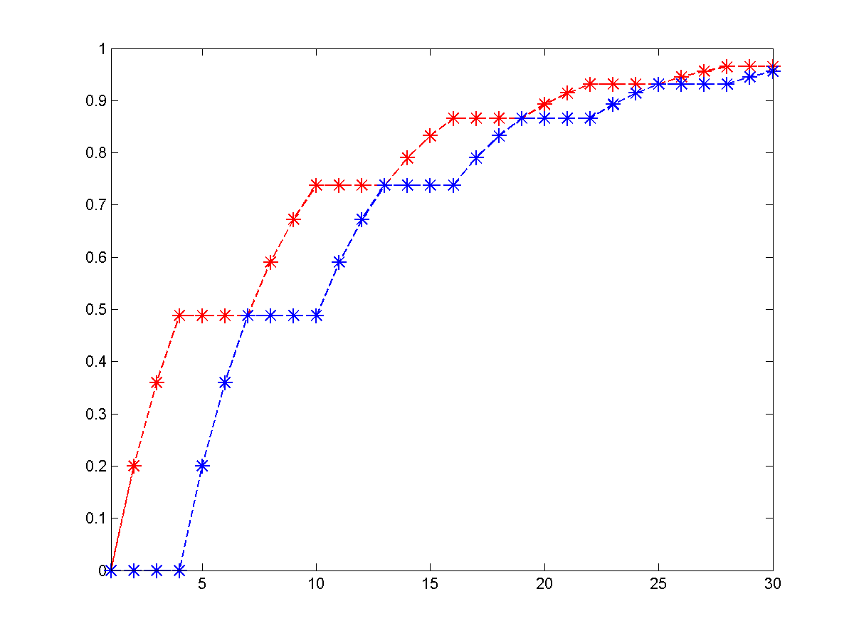
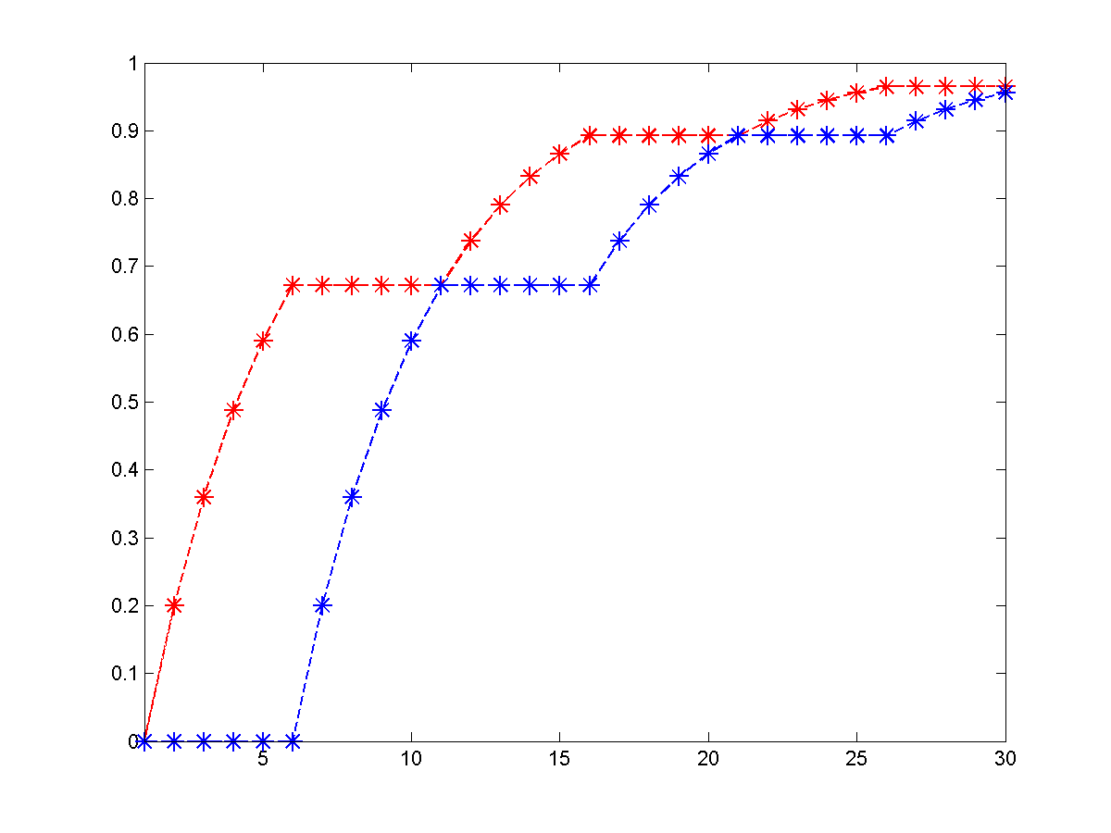
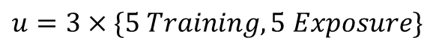
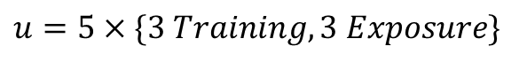
Simulations (I): Interleaved
$u=5×\{3 Training,3 Exposure\}$
$u=3×\{5 Training,5 Exposure\}$

Slide 20
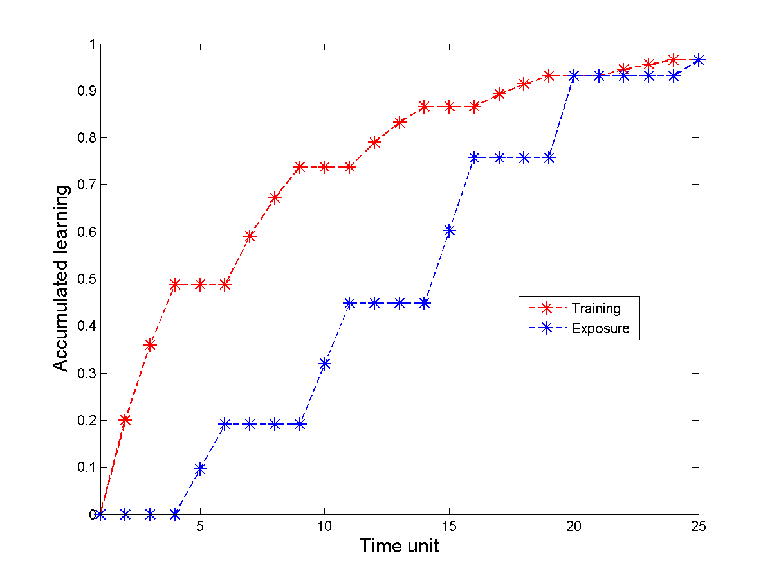
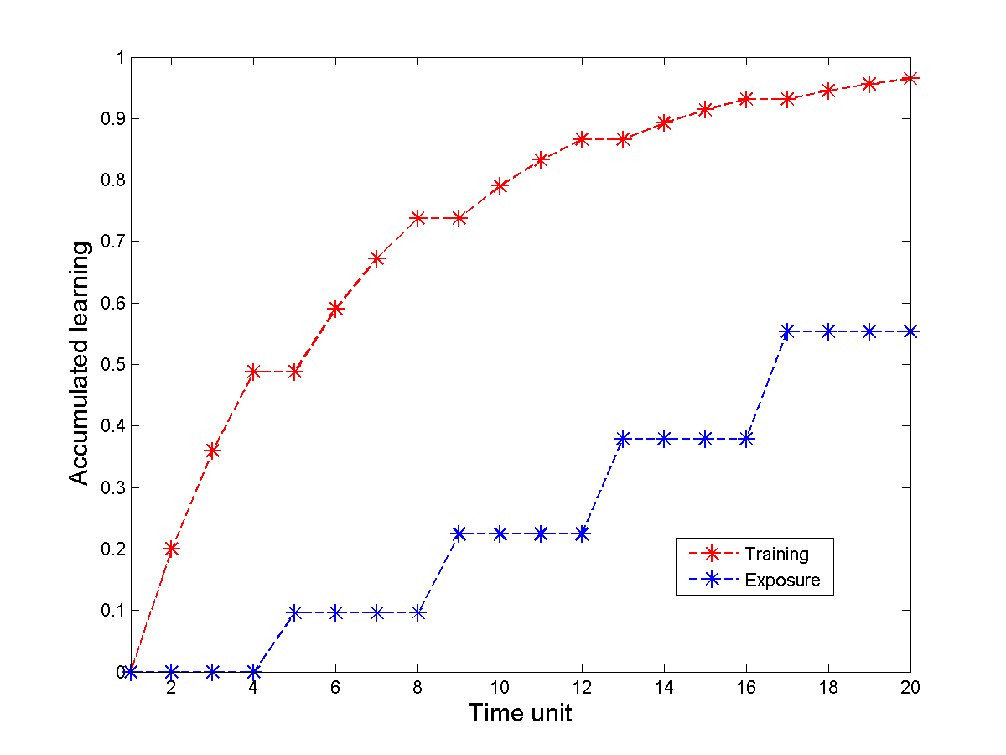
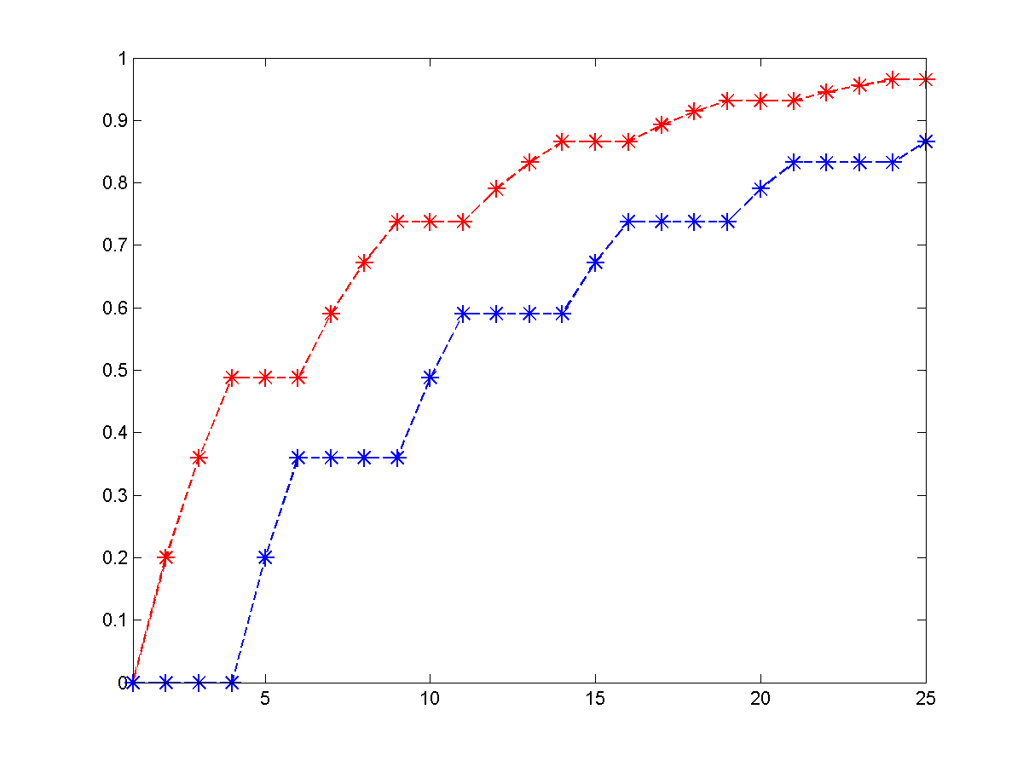
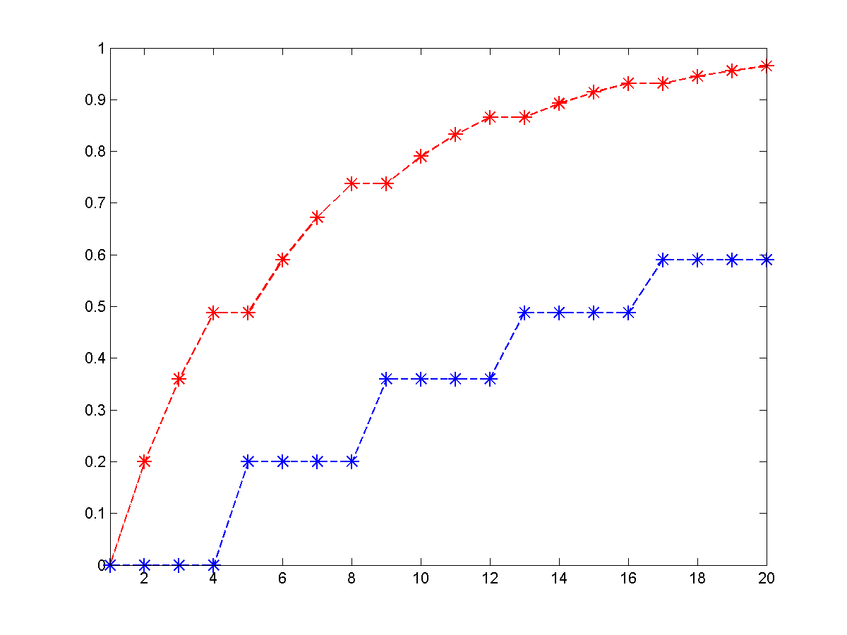
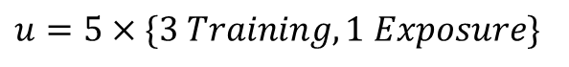
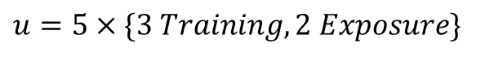
Simulations (I): Reduced Exposure
$u=5×\{3 Training,2 Exposure\}$
$$u=5×\{3 Training,1 Exposure\}$$
Notes:
Results must relate to the hypothesis. Explicit

Slide 21
Simulations (II)
It is assumed that 17 training blocks are needed for complete learning.
All of these simulations are novel situations that have not been experimentally verified.

Slide 22
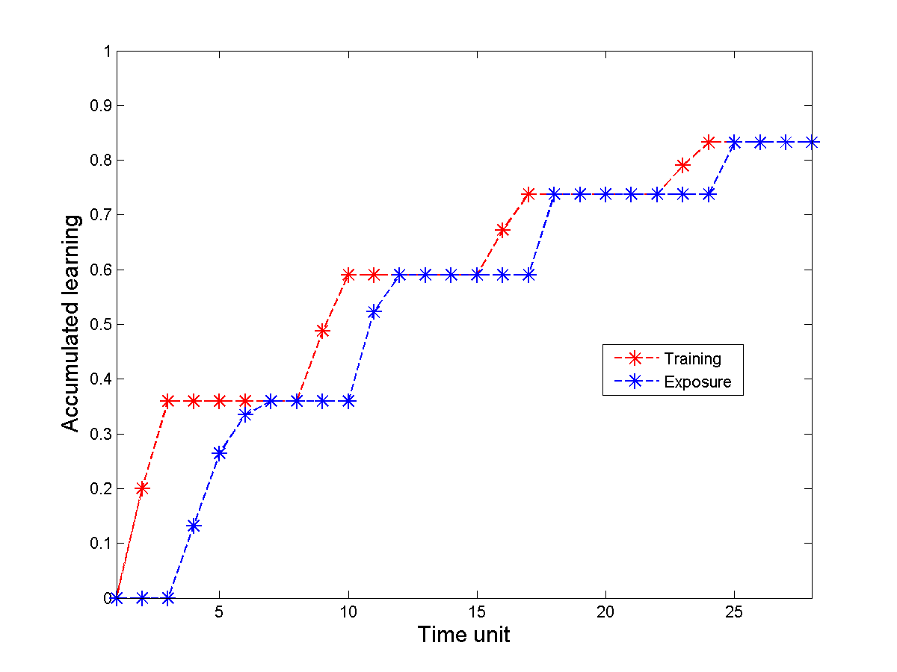
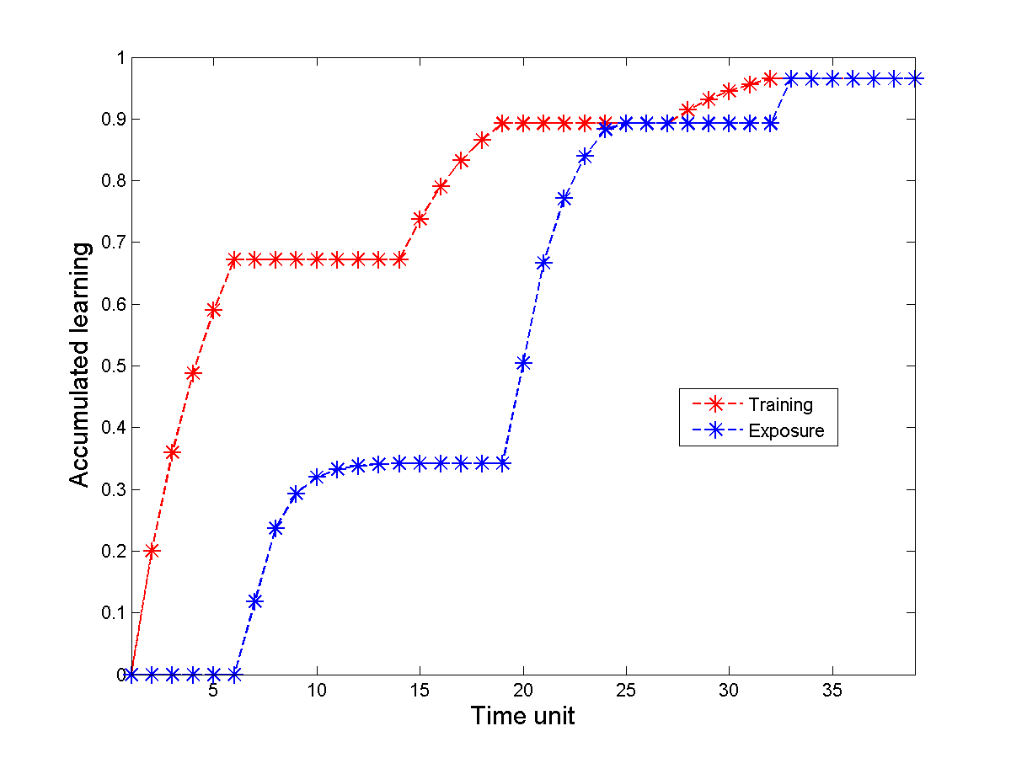
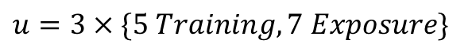
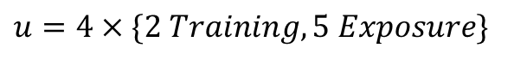
Simulations (II)
$$u=4×\{2 Training,5 Exposure\}$$
$$u=3×\{5 Training,7 Exposure\}$$
Notes:
Results must relate to the hypothesis. Explicit

Slide 23
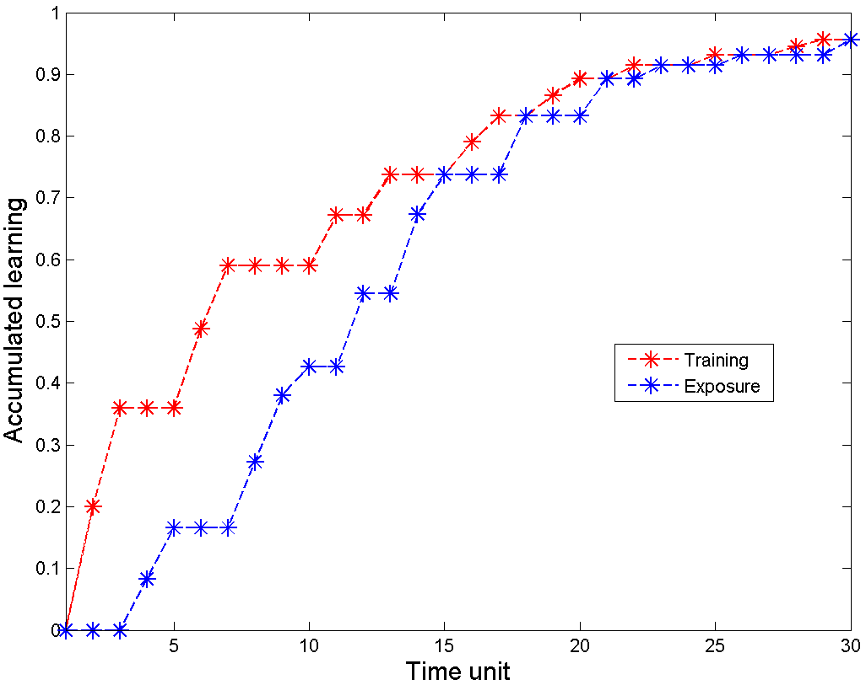
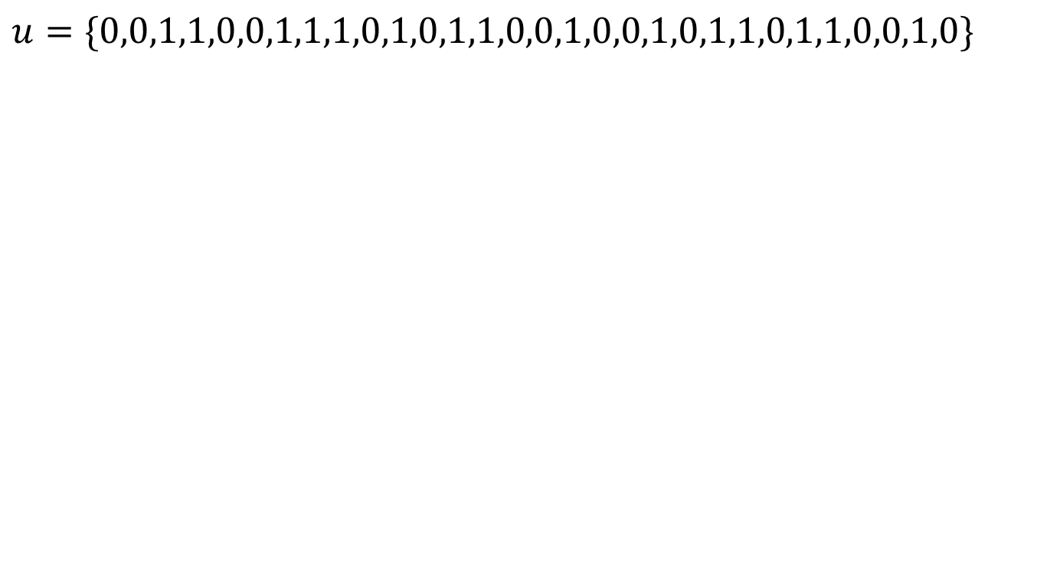
Simulations (II)
$$u=\{0,0,1,1,0,0,1,1,1,0,1,0,1,1,0,0,1,0,0,1,0,1,1,0,1,1,0,0,1,0\}$$
Notes:
Random permutations are done between equal number of training and exposure blocks.

Slide 24
Simulation Conclusions
A “boosting” mechanism in the learning rate of the exposure phases gives an explanation for all the observed full transfer behavior in the data.
Notes:
How model relates to hypotheses

Slide 25
Critical model evaluation
Our model can be generalized to other visual perceptual tasks (Zhang et al, 2010).
Insufficient data to assess other combinations of training and exposure blocks, however, the model creates predictions for future experiments.
E.g., arbitrary increasing the length of the exposure phases does not lead to better performance at the testing angle.
Careful hand-tuning is required.
The model does not account for temporal decay of retention.
Notes:
and overnight consolidation

Slide 26
Summary & conclusions
What have you learned?
Model parameters have a significant impact on fitting its outcomes to the qualitative behavior of the data
Additional testing of subjects will allow us to subject our model to more elaborate edge-case testing.
Future work
We expect to extend our model to account for generalization in the double-training tasks.
Notes:
This should come back to the objectives

Slide 27
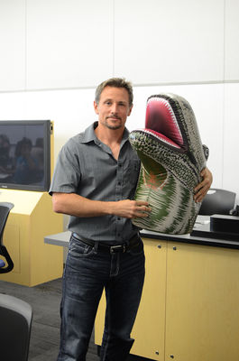

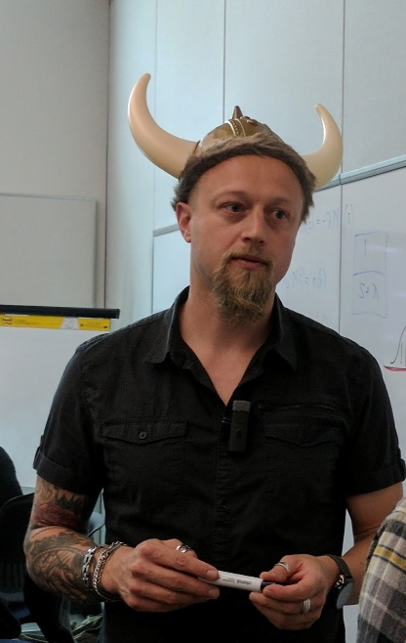
Thank you!

Slide 28
References
Crist, R. E., Kapadia, M. K., Westheimer, G., & Gilbert, C. D. (1997). Perceptual learning of spatial localization: specificity for orientation, position, and context. Journal of neurophysiology, 78(6), 2889-2894.
Fahle, M. (1994). Human pattern recognition: parallel processing and perceptual learning. Perception, 23(4), 411-427.
Zhang, J. Y., Zhang, G. L., Xiao, L. Q., Klein, S. A., Levi, D. M., & Yu, C. (2010). Rule-based learning explains visual perceptual learning and its specificity and transfer. Journal of Neuroscience, 30(37), 12323-12328
Schoups, A. A., Vogels, R., & Orban, G. A. (1995). Human perceptual learning in identifying the oblique orientation: retinotopy, orientation specificity and monocularity. The Journal of physiology, 483(3), 797-810.
Xiao, L. Q., Zhang, J. Y., Wang, R., Klein, S. A., Levi, D. M., & Yu, C. (2008). Complete transfer of perceptual learning across retinal locations enabled by double training. Current Biology, 18(24), 1922-1926.

Slide 29
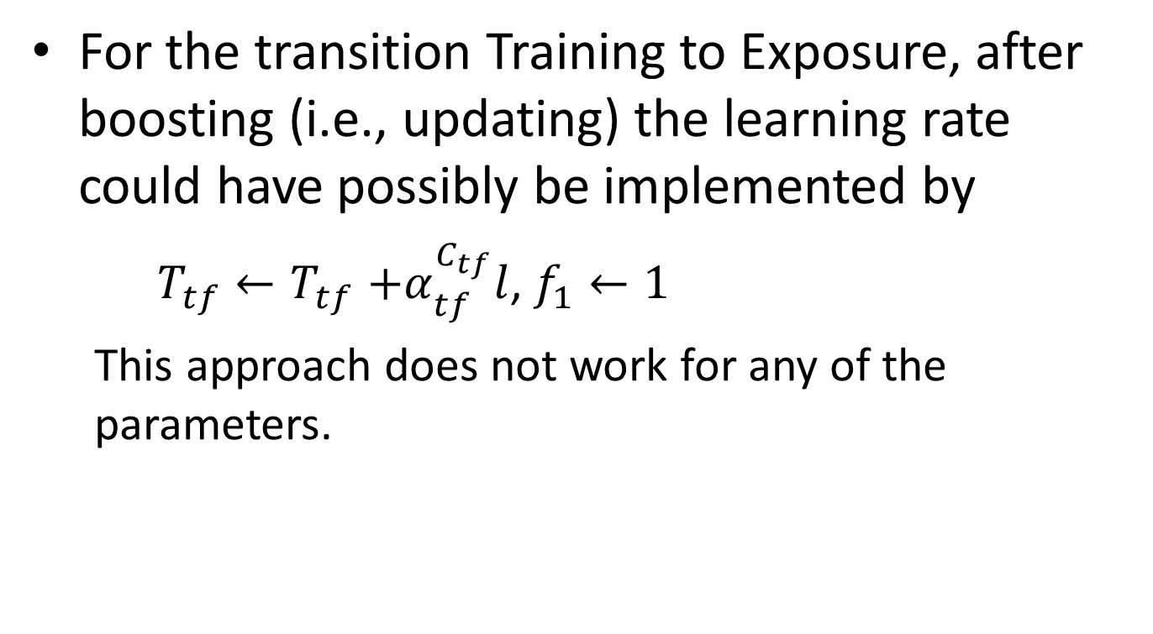
Additional slides
For the transition Training to Exposure, after boosting (i.e., updating) the learning rate could have possibly be implemented by
$T_{tf}{←T}_{tf}+α_{tf}^{C_{tf}}l$, $f_{1}←1$
This approach does not work for any of the parameters.

Slide 30
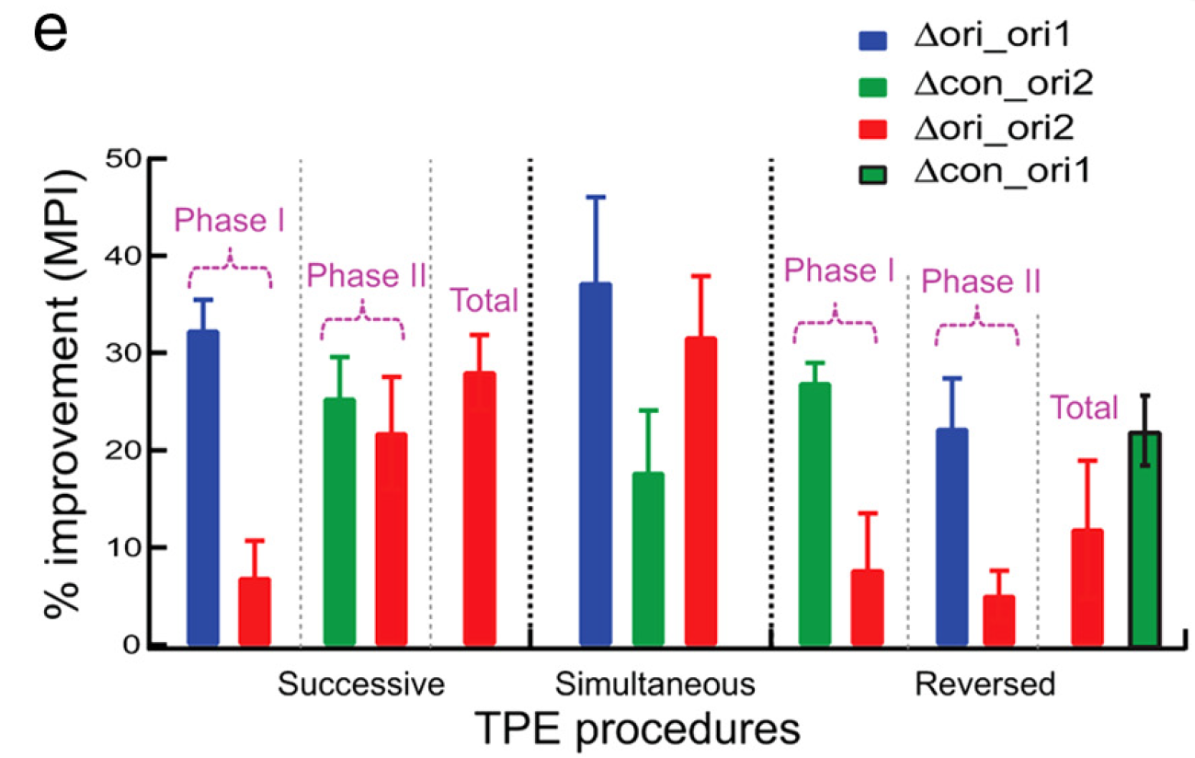

Slide 31
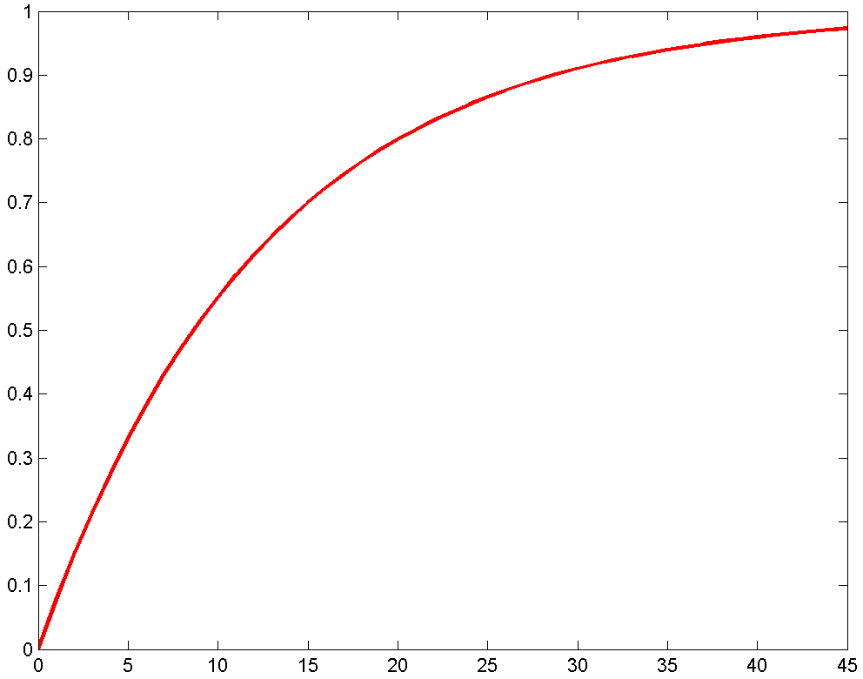
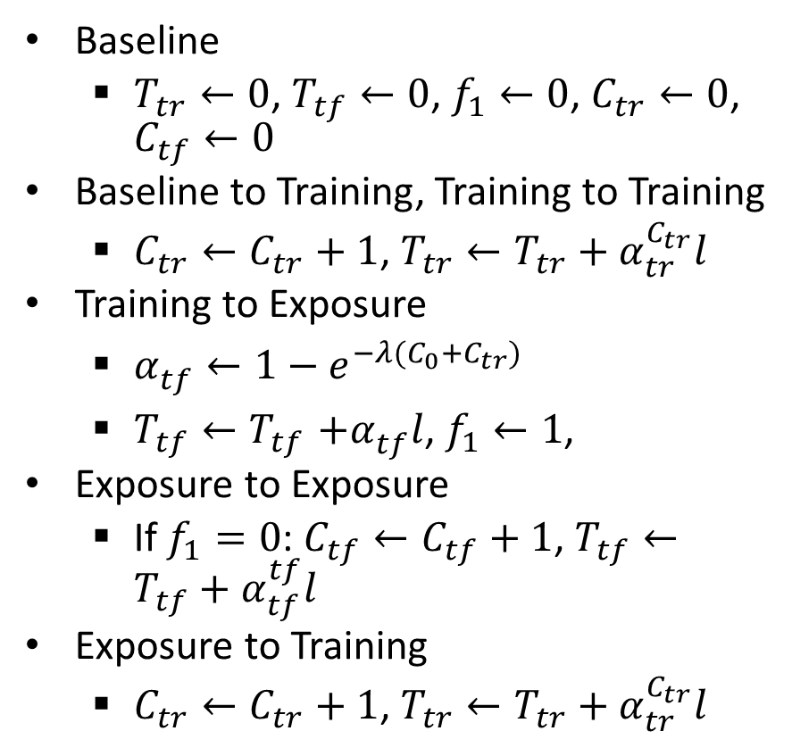
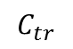
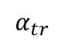
Equations
Baseline
$T_{tr}←0$, $T_{tf}←0$, $f_{1}←0$, $C_{tr}←0$, $C_{tf}←0$
Baseline to Training, Training to Training
$C_{tr}←C_{tr}+1$, $T_{tr}←T_{tr}+α_{tr}^{C_{tr}}l$
Training to Exposure
$α_{tf}^{}←1−e^{−λ(C_{0}+C_{tr})}$
$T_{tf}{←T}_{tf}+α_{tf}^{}l$, $f_{1}←1$,
Exposure to Exposure
If $f_{1}=0$: $C_{tf}←C_{tf}+1$, $T_{tf}←T_{tf}+α_{tf}^{tf}l$
Exposure to Training
$C_{tr}←C_{tr}+1$, $T_{tr}←T_{tr}+α_{tr}^{C_{tr}}l$
$$α_{tr}$$
$$C_{tr}$$
Notes:
Boost in transfer learning rate.
Decay rate for exposure phases: $α_{tf}^{}$

Slide 32
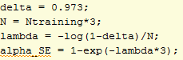
Exponential
$$α_{tr}$$
$$C_{tr}$$

Slide 33
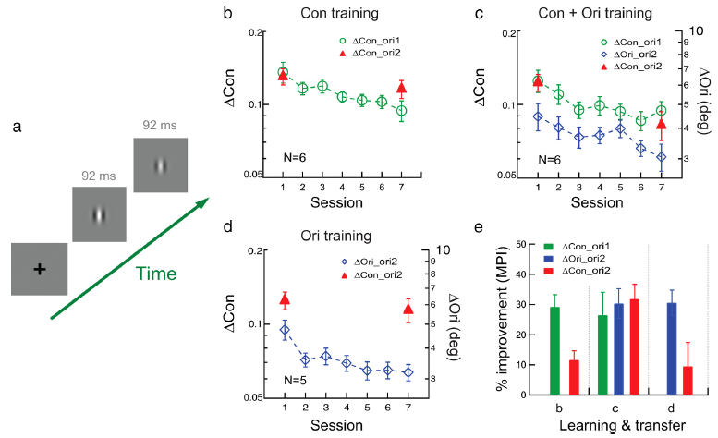
Double-training
Learning transfer occurs also when the tasks are reversed (e.g. when contrast discrimination is being tested)

Slide 34
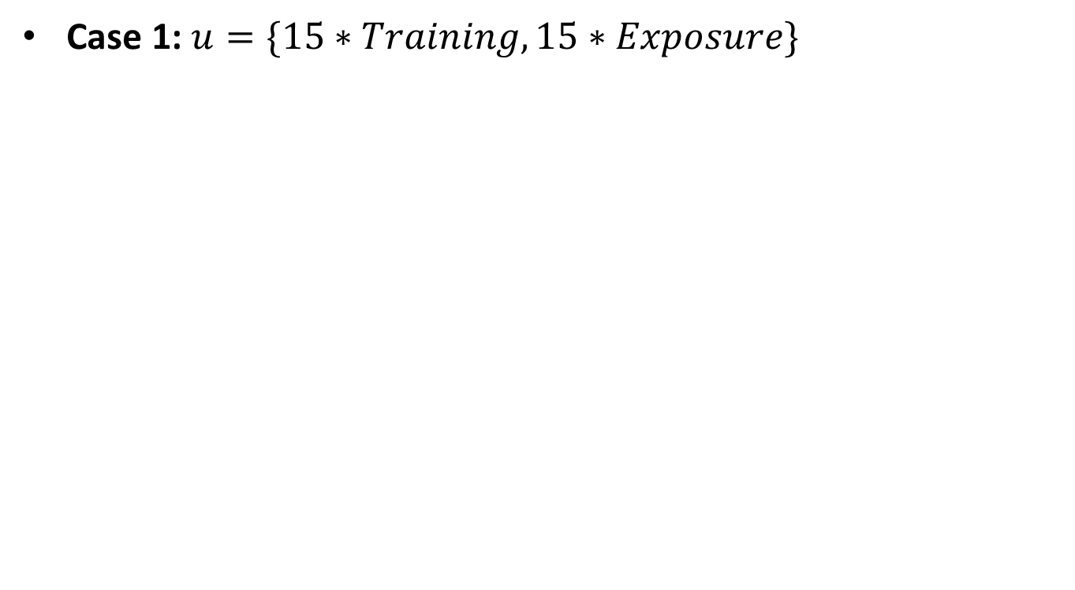
Simulations / results
Case 1: $u=\{15∗Training,15∗Exposure\}$
Notes:
Results must relate to the hypothesis. Explicit

Slide 35
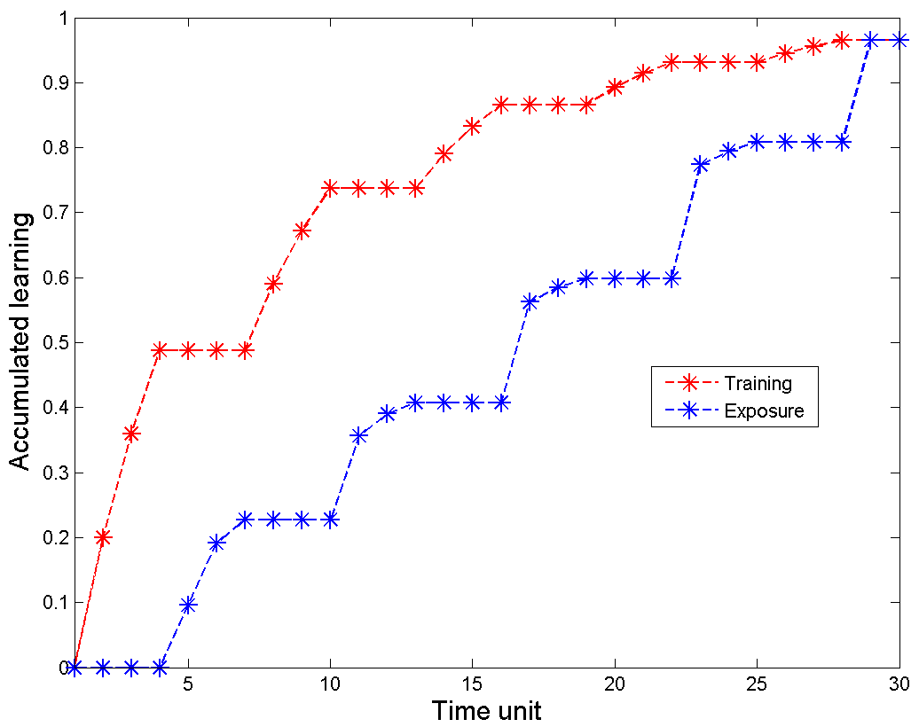
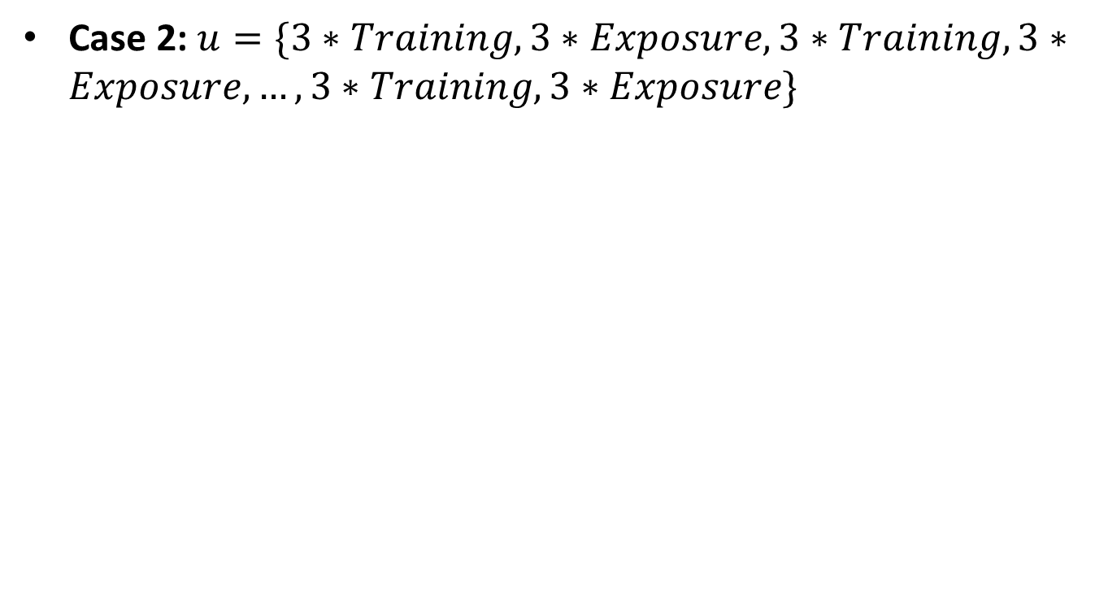
Simulations / results
Case 2: $u=\{3∗Training,3∗Exposure,3∗Training,3∗Exposure,…,3∗Training,3∗Exposure\}$
Notes:
Results must relate to the hypothesis. Explicit

Slide 36
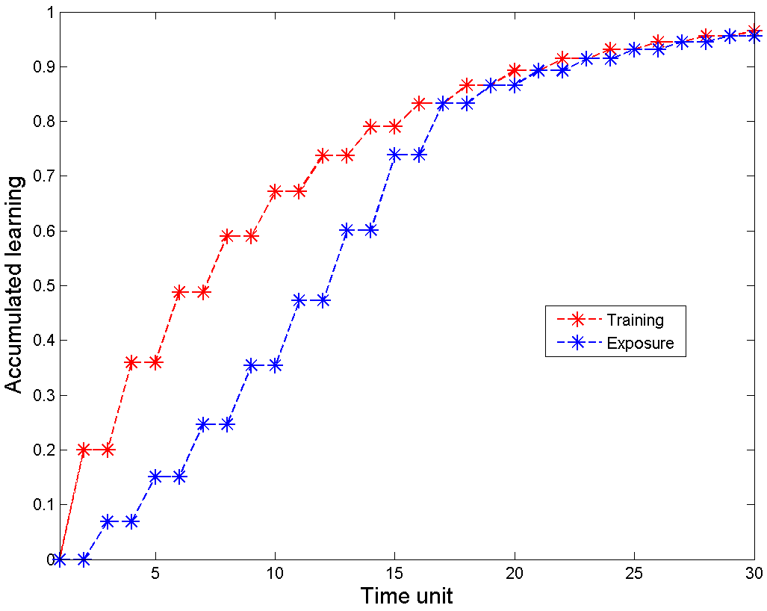
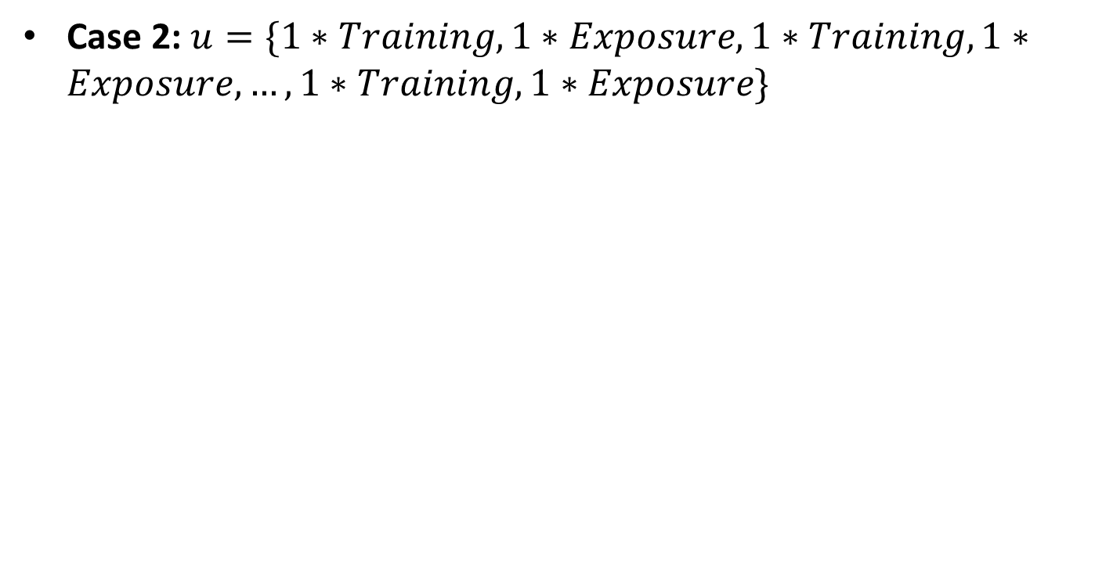
Simulations / results
Case 2: $u=\{1∗Training,1∗Exposure,1∗Training,1∗Exposure,…,1∗Training,1∗Exposure\}$
Notes:
Results must relate to the hypothesis. Explicit

Slide 37
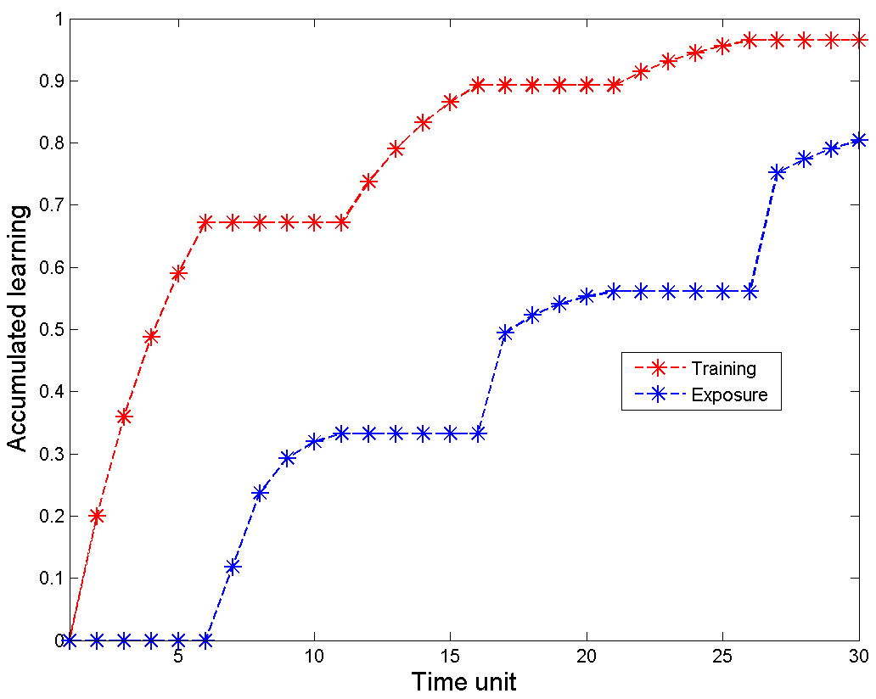
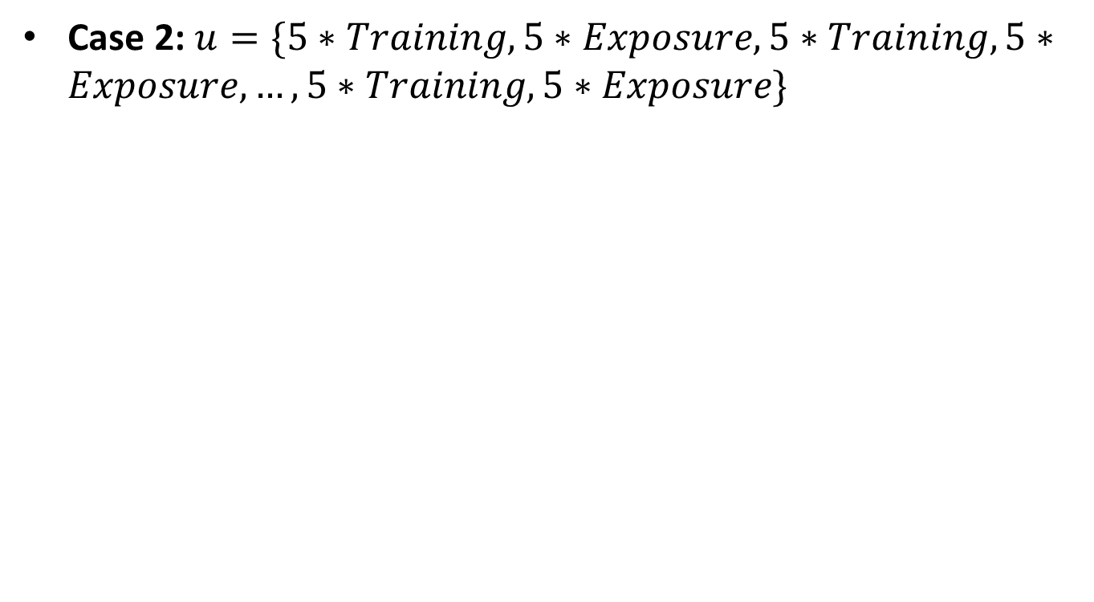
Simulations / results
Case 2: $u=\{5∗Training,5∗Exposure,5∗Training,5∗Exposure,…,5∗Training,5∗Exposure\}$
Notes:
Results must relate to the hypothesis. Explicit

Slide 38
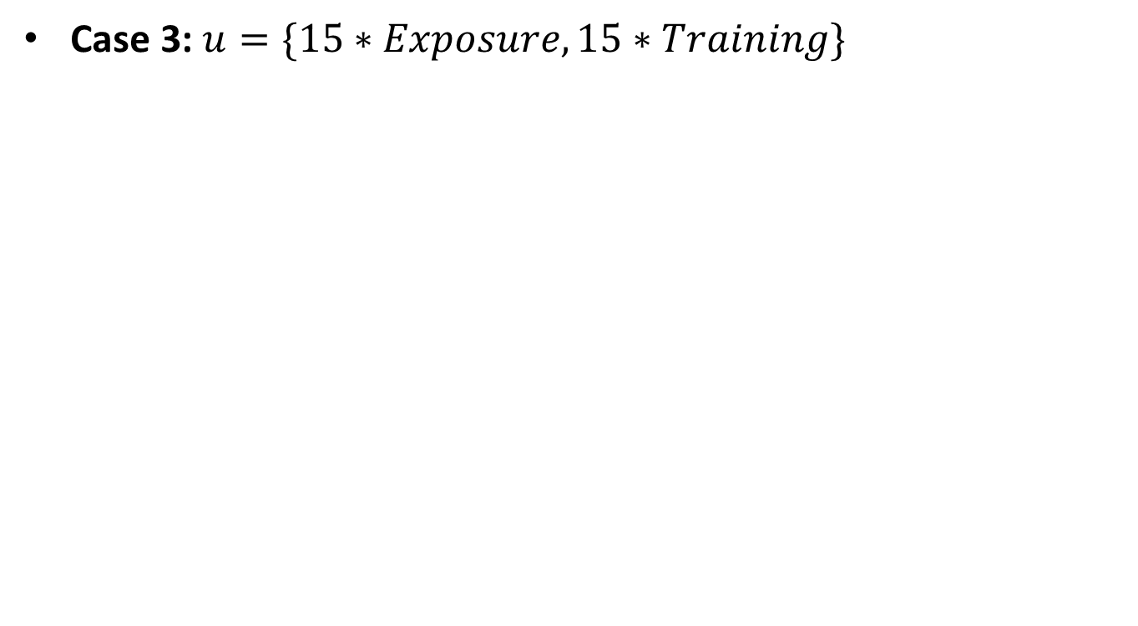
Simulations / results
Case 3: $u=\{15∗Exposure,15∗Training\}$
Notes:
Results must relate to the hypothesis. Explicit

Slide 39
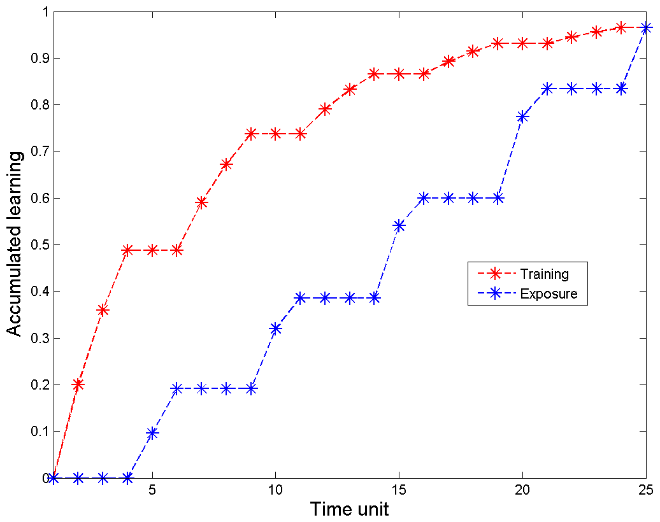
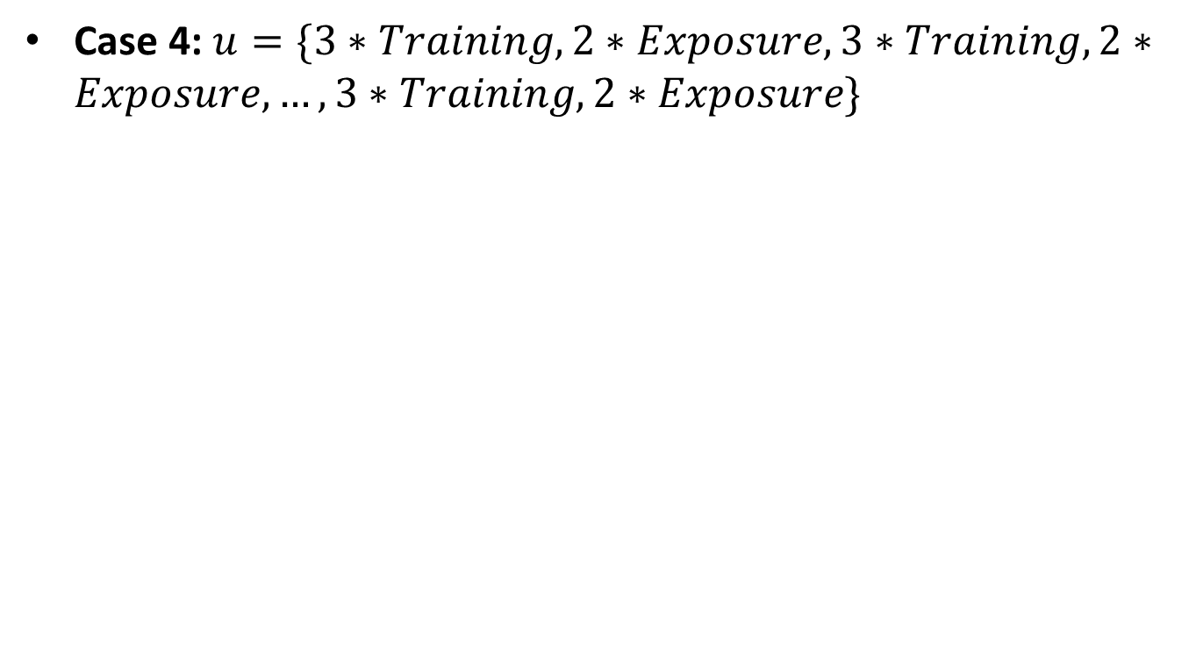
Simulations / results
Case 4: $u=\{3∗Training,2∗Exposure,3∗Training,2∗Exposure,…,3∗Training,2∗Exposure\}$
Notes:
Results must relate to the hypothesis. Explicit

Slide 40

Simulations / results
New case: $u=\{3∗Training,1∗Exposure,3∗Training,1∗Exposure,…,3∗Training,1∗Exposure\}$
Notes:
Results must relate to the hypothesis. Explicit

Slide 41


Simulations / results
Case 4: $u=\{5∗Training,3∗Exposure,5∗Training,3∗Exposure,…,5∗Training,3∗Exposure\}$
Notes:
Results must relate to the hypothesis. Explicit

Slide 42
Prevalent conjectures
Rule based learning (Zhang et al, 2010)
V1 inputs representing untrained orientations or retinal locations are unattended and likely suppressed.
Orientation exposure or location training establishes connections that enable learning transfer by reactivating the unattended or suppressed V1 inputs.
No computational model that explains how double-learning evokes learning transfer
Notes:
Conjecture

Slide 43


Simulations
$u=15×\{1 Training,1 Exposure\}$ (Case 2)
Notes:
Results must relate to the hypothesis. Explicit

Slide 44



Simulations
$u=3×\{5 Training,3 Exposure\}$(Case 4)
Notes:
Results must relate to the hypothesis. Explicit

Slide 45



Simulations
$$u=3×\{5 Training,2 Exposure\}$$
Notes:
Results must relate to the hypothesis. Explicit

Slide 46


Simulations
$$u=\{\text{0}\text{,1,1,0,0,0,1,1,1,1,0,1,0,1,0,0,0,0,1,1,0,0,1,1,1,0,1,0,0,1}\}$$
Notes:
Results must relate to the hypothesis. Explicit

